Slide 1
Linear Model Improvements
© 2025 Virginia Polytechnic Institute and State University. All rights reserved.

Slide 2
At the end of this module, you should be able to:
Understand why you would want to improve a linear model
Identify methods that can be used to improve the linear model
Describe approaches to subset selection
Explain what is meant by shrinkage
Describe the difference between ridge regression and LASSO
Describe what is meant by dimension reduction
Identify two approaches to dimension reduction
Implement model adjustment methods in Python

Slide 3
Linear Model Improvements

Slide 4
Introduction to Machine Learning Course Roadmap
What is the goal of the data analysis?
Predict an output |  |  |  |  |  | Reveal patterns or relationships |  | Make decisions using an autonomous agent
Supervised Learning (Output in the data set) |  |  |  |  |  | Unsupervised Learning (No output in the data set) |  | Reinforcement Learning* (Supervised & unsupervised)
Continuous or discrete output? |  |  |  |  |  | What is the subgoal? |  | Does a model exist?
Continuous |  |  | Discrete |  |  | Identify groups | Reduce dimensions | Model Based | Model Free
Simple linear regression Multiple linear regression Subset selection Ridge regression & LASSO PCR & PLS | Polynomial regression Step functions Splines Local regression General additive models | Decision tree Random forest Neural network Gradient boosting tree | Logistic regression Linear discriminant analysis Quadratic discriminant analysis | Decision tree Random forest Neural network Gradient boosting tree | Support vector machines | Hierarchical clustering K-means clustering | Principal components analysis | Given the model Learn the model | Policy Optimization Q-Learning
Simple linear regression
Multiple linear regression
*Advanced Topic: Bonus module if time
Notes:
In the introductory module, we reviewed concepts related to simple and multiple linear regression for supervised learning with a continuous output. We are now going to extend to a set of techniques that can improve those models

Slide 5
Supervised versus unsupervised again
Some tangible measurement(s)
“The Black Box”
INPUTS
MACHINE LEARNING MODEL
OUTPUT(S)
Supervised Learning
In the context of domain knowledge
“The Black Box”
INPUTS
MACHINE LEARNING MODEL
PATTERNS,
RELATIONSHIPS, STRUCTURE
Unsupervised Learning
does it make sense?
Notes:
In the machine learning modules, we always want to ground you in the application of the techniques presented. The linear model improvement techniques in this module can be used in supervised learning.

Slide 6
Supervised learning method selection is based on the response type
Is my response quantitative or qualitative?
Age
Height
Income
Stock Price
Tensile Strength
Quantitative
Qualitative
Blood Type
Default on Debt (y/n)
Cancer Stage
Brand Purchased
Species
Typically use regression method
Typically use classification method
Discrete: Nominal or Ordinal
Continuous Measures
What about the predictors?
For most methods, predictors can be
either quantitative or qualitative.
Notes:
As suggested in the title, we are focused on regression methods with continuous responses. Although, variable selection can be applied to logistic regression classification models as well as other parametric models.

Slide 7
Two methods of estimation
Parametric
(Less Flexible, More Interpretable)
Non-parametric
(More Flexible, Less Interpretable)
Inference focused
Select a model which involves an assumption about the functional form of f. Train the model and estimate parameters.
Example:
f is linear in X: f(X) = β₀+β₁X₁ + β₂X₂ +…+ β_{p}X_{p}
Prediction focused
Does not make explicit assumptions about the functional form of f. Can fit wider range of possible shapes for f, but at that cost of needing a larger number of observations.
Example:
Splines
Notes:
Traditional linear model improvement methods apply to parametric models

Slide 8
Example: College applications
We are interested in predicting the number of accepted college applications
Our dataset contains 17 possible predictors (or inputs or Xs)
Should we include all of these in the model?
Probably not…
Private
Top25perc
Books
perc.alumni
Apps
F.Undergrad
Personal
Expend
P.Undergrad
PhD
Grad.Rate
Enroll
Outstate
Terminal
Top10perc
Room.Board
S.F.Ratio
How do we choose which variables to use?
Notes:
Multiple linear regression would allow us to include all 17 variables in the model. But should we? Probably not. You may be asking, why wouldn’t we want to include all possibly information we have, even is it only lends a little bit of information to solving the problem? This goes back to the concept of an over-fitted model and the tradeoff between flexibility and interpretability. The more terms you add into your model, the more flexible you model will be. This may sound like a good thing, but, in reality, too much flexibility leads to overfitting your model to the data in hand. We may run the risk of predicting well in the short term but not in the long term. Ideally, we want to select just a few of these variables that provide the most information about the percent of families below the poverty line. So how do we choose which variables to use?

Slide 9
Improving the linear model
The linear model is often a robust choice for approaching a problem
Some adjustments can be made to the linear model to:
Avoid Overfitting: Including too many predictors can lead to a model that fits the noise in the training data rather than the true signal.
Enhance Predictive Performance: Reducing unnecessary predictors can improve generalizability to new data.
Improve Interpretability: Simpler models are easier to understand and explain.
Reduce Multicollinearity: Removing redundant predictors helps stabilize coefficient estimates.
Notes:
This problem presents a case where we can improve upon the linear model. While we could fit the model with all 17 variables, we know this could lead to issues with interpretability and overfitting. This module examines three approaches to hopefully improving upon the full linear model.

Slide 10
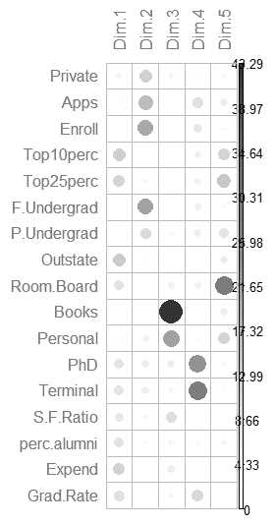
Predicting the number of college applications
Private
Top25perc
Books
perc.alumni
Apps
F.Undergrad
Personal
Expend
P.Undergrad
PhD
Grad.Rate
Enroll
Outstate
Terminal
Top10perc
Room.Board
S.F.Ratio
Top25perc
Apps
Expend
Enroll
Outstate
Top10perc
Private
Top25perc
Books
perc.alumni
Apps
F.Undergrad
Personal
Expend
P.Undergrad
PhD
Grad.Rate
Enroll
Outstate
Terminal
Top10perc
Room.Board
S.F.Ratio
Start
Subset
Shrink
Dimension Reduction
Notes:
This slide is intended to provide a motivating example for the topics covered.
The linear model is often a robust choice for approaching a problem, like the one we see here, predict number of college applications accepted
Some adjustments can be made to the linear model to improve interpretability, reduce estimator variability, and overcome data shortage that would preclude the estimation of all parameters in the model (i.e. fewer observations than parameters)
We often start with a long list of potential predictors.
We will look at ways of improving linear models that focus on identifying or reducing the set of predictors to a more parsimonious set of predictors that will allow us to still do a good job predicting the outcome.
We will examine 3 approaches:
Subset Selection
Shrinkage
Dimension Reduction
Subset selection focuses on getting the right variables. While shrinkage and dimension reduction focus on reducing the effect of correlated predictors

Slide 11
Introduction to Machine Learning Course Roadmap
What is the goal of the data analysis?
Predict an output |  |  |  |  |  | Reveal patterns or relationships |  | Make decisions using an autonomous agent
Supervised Learning (Output in the data set) |  |  |  |  |  | Unsupervised Learning (No output in the data set) |  | Reinforcement Learning* (Supervised & unsupervised)
Continuous or discrete output? |  |  |  |  |  | What is the subgoal? |  | Does a model exist?
Continuous |  |  | Discrete |  |  | Identify groups | Reduce dimensions | Model Based | Model Free
Simple linear regression Multiple linear regression Subset selection Ridge regression & LASSO PCR & PLS | Polynomial regression Step functions Splines Local regression General additive models | Decision tree Random forest Neural network Gradient boosting tree | Logistic regression Linear discriminant analysis Quadratic discriminant analysis | Decision tree Random forest Neural network Gradient boosting tree | Support vector machines | Hierarchical clustering K-means clustering | Principal components analysis | Given the model Learn the model | Policy Optimization Q-Learning
Subset selection
Ridge regression & LASSO
PCR & PLS
*Advanced Topic: Bonus module if time
Notes:
This module examines three approaches to improving the full linear model.
Subset Selection
Shrinkage methods including ridge regression and LASSO
Dimension Reduction methods including principal components regression and partial least squares

Slide 12
Linear Model Improvements

Slide 13
Predicting the number of college applications
Private
Top25perc
Books
perc.alumni
Apps
F.Undergrad
Personal
Expend
P.Undergrad
PhD
Grad.Rate
Enroll
Outstate
Terminal
Top10perc
Room.Board
S.F.Ratio
Top25perc
Apps
Expend
Enroll
Outstate
Top10perc
Start
Subset
Notes:
Recall our example where we are interested in predicting the number of college applications. While we could fit the multiple linear regression model with all 17 variables, we know this could lead to issues with interpretability and overfitting. So let’s start looking at ways to improve the model with subset selection.
Subset selection focuses on getting the right variables. While shrinkage and dimension reduction focus on reducing the effect of correlated predictors

Slide 14
Subset selection only uses a subset of available inputs to fit the model
Subset selection often helps with interpretability and overcoming small dataset limitations
We will cover three types of subset selection:
Best subset selection
Forward stepwise selection
Backward stepwise selection
Notes:
As we have already alluded to, subset selection involves using only a subset of available features to fit the model, which often helps with interpretability and also overcoming small dataset limitations. The three types of subset selection we will cover are Best Subset Selection, Forward Stepwise Selection, and Backward Stepwise Selection.
Note: Mixed stepwise selection is another type of subset selection that combines forward and backward but will not be covered here

Slide 15
In best subset selection, we fit all possible models
We fit all possible linear models and then pick the “best” one
No Variables
(Intercept Only)
Variable 1 Variable 2 Variable 3
Variable 4
Variable 1
Variable 2
Variable 3
Variable 4
Variables
1, 2
Variables
1, 3
Variables
1, 4
Variables
2, 3
Variables
2, 4
Variables
3, 4
Variables 1, 2, 3
Variables 1, 2, 4
Variables 1, 3, 4
Variables 2, 3, 4
Variables 1, 2, 4
Variables 1, 2, 3, 4
the best model contains variables 1, 2, and 4
Notes:
We will begin with best subset selection. In Best subset selection we fit all possible combination of variables, in other words, all possible linear models, and pick the “best” one. So for example, if you had four possible variables to add to the model, a best subset procedure would fit a model with none of the variables, the four possible models with one variable each, the six possible models with 2 variables each, the four possible models with three variables each, and lastly, the model with all four variables. It would then compare all of these models to determine which is considered best, which in this case, is the model with variables 1, 2, and 4.

Slide 16
In ML, we focus on test MSE to select the “best” subset, but there are other metrics
Common metrics for selecting the “best” subset:
Test MSE (prediction error)
Mallow’s Cp
AIC
BIC
Adjusted R²
Lower is better
Higher is better
Notes:
So how do we determine which is “best”? The are five commonly used metrics for determining which model is best. The first four metrics are prediction error, mallow’s cp, AIC, and BIC, and for these metrics, a lower value is considered better. The last metric is adjusted R-square and higher is better.
In ML, we focus on prediction error or Test MSE, so we will not go into the technical details of the other 4 metrics in this class

Slide 17
In forward stepwise selection, we add variables one at a time
We add variables to the linear model one at a time and keep the variable that results in the largest reduction in error
The process is repeated until there is minimal gain by adding another variable
Variable 1
Variables 4, 1
Variable 1 Variable 2 Variable 3
Variable 4
Variables 4, 1
Variables 4, 1, 2
Variable 2
Variables 4, 2
No Variables (Intercept Only)
Variables 4, 1, 3
Variables 4, 1, 3
Variable 3
Variables 4, 3
Variable 4
the best model contains variables 1, 3, and 4
Variable 4
Notes:
The next technique is forward stepwise selection, where we start with the linear model with no variables, so just the intercept, and add variables one at a time until there is minimal reduction in error by adding an additional variable. Note that once a variable is added, it cannot be removed at a later stage. So for our example of 4 possible variables, forward selection starts with no variables and then looks at which single variable, when added to the model, produces the greatest reduction in error, and add that to the model. In this case, variable 4 is added. We then look at the model with variable 4 and see which of variables 1, 2, and 3, result in the greatest reduction in error, in this case, variable 1. We do this again and variable 3 is added. At this point, the method looks add how error is reduced by adding variable 2 and determines the reduction in error is not worth the additional complexity of adding another variable. The process concludes with variables 1, 3, and 4 being the “best” subset. Note this is a different result than we got from best subset selection, but this is not always the case. Sometimes the results will agree

Slide 18
In backward stepwise selection we remove one variable at a time
We remove variables from the full linear model one at a time, starting with the variable whose removal results in the smallest increase in error
The process is repeated until there is minimal gain by removing another variable
Variables 1, 2, 3
Variables 1, 2, 3
Variable 1 Variable 2 Variable 3
Variable 4
Variables 1, 2
Variables 1, 2, 4
Variables 1, 3
Variables 1, 2, 3, 4
Variables 1, 3
Variables 1, 3, 4
Variables 2, 3
the best model contains variables 1 and 3
Variables 2, 3, 4
Notes:
Lastly, we have backward stepwise selection, where we start with the full model, so the model with all possible variables, and remove a variable one at a time until there is minimal increase in error. Note that once a variable is removed, it cannot be added back in at a later stage. So for our example, we start with the model containing all four variables and remove the variable whose removal results in the least increase in error. In this case, this is variable 4, and we have the model with just variables 1, 2, and 3. We then remove variable 2 based on how error increases and the procedure stops as no removals are worth the increased error. In this case, we get the model with just variables 1 and 3, which is different from our previous results.

Slide 19
Pros and cons of subset selection
Method | Pros | Cons
Best subset selection | Finds the best linear model | Computationally intensive
Forward stepwise selection | Computationally less intensive | May not find the absolute best variable combination
Backward stepwise selection | Computationally less intensive | May not find the absolute best variable combination Cannot be used if we have more predictors (input variables) than observations
Notes:
This table summarizes the pros and cons of the three methods we just discussed. This may be obvious, but a pro of best subset selection is that it finds the best linear model. But you can imagine that, as the number of possible predictors increases, the model linear models need to be fit to determine which is best. This can be very computationally expensive, and potentially impossible for very large data sets. This is typically not as much of a problem for forward or backward stepwise selection. They are usually less computationally intensive as they do not compute all possible models. The con to these methods is that they are not guaranteed to find the best variable combination. We saw this demonstrated in our example where backward selection settled on a different model than best subset selection. Another downside to backward stepwise selection is that it cannot be used when we have more variables in our data than we do observations.

Slide 20
Linear Model Improvements

Slide 21
Predicting the number of college applications
Private
Top25perc
Books
perc.alumni
Apps
F.Undergrad
Personal
Expend
P.Undergrad
PhD
Grad.Rate
Enroll
Outstate
Terminal
Top10perc
Room.Board
S.F.Ratio
Top25perc
Apps
Expend
Enroll
Outstate
Top10perc
Private
Top25perc
Books
perc.alumni
Apps
F.Undergrad
Personal
Expend
P.Undergrad
PhD
Grad.Rate
Enroll
Outstate
Terminal
Top10perc
Room.Board
S.F.Ratio
Start
Subset
Shrink
Notes:
Recall our example where we are interested in predicting the number of college applications. While we could fit the multiple linear regression model with all 17 variables, we know this could lead to issues with interpretability and overfitting. In the last section, we looked at subset selection methods that completely remove some variables.
Now let’s explore shrinkage methods
Shrinkage methods are used for correlated Xs in regression. Some shrinkage methods also incorporate the concept of variable selection.
​
Subset selection focuses on getting the right variables. While shrinkage and dimension reduction focus on reducing the effect of correlated predictors

Slide 22
Shrinkage methods “shrink” the value of predictor coefficient estimators towards zero
Shrinkage methods prevent overfitting, help with variable selection, reduce the impact of multicollinearity, and overcome small dataset limitations
We will cover two shrinkage methods:
Ridge regression
LASSO (least absolute shrinkage and selection operator)
Notes:
Shrinkage allows some adjustments to be made to the linear model to improve interpretability, reduce estimator variability, and overcome data shortage that would preclude the estimation of all parameters in the model (i.e. fewer observations than parameters).​
Reduces the impact of multicollinearity on individual parameter estimates​
Helps with variable selection​
Allows for model fitting in the situation where n < k where n is the total number of data points and k is the number of regressors you want to include in a mode
We will provide an overview of:​
Ridge Regression​
LASSO
Ridge regression was initially introduced in the 1970s and further developed in the subsequent decades to become a standard practice in statistical software. LASSO (and elastic net which is not covered in this course) are extensions of ridge regression that also incorporate the problem of model selection and help overcome a shortage of data where we have fewer data points then independent variables we want to include.​

Slide 23
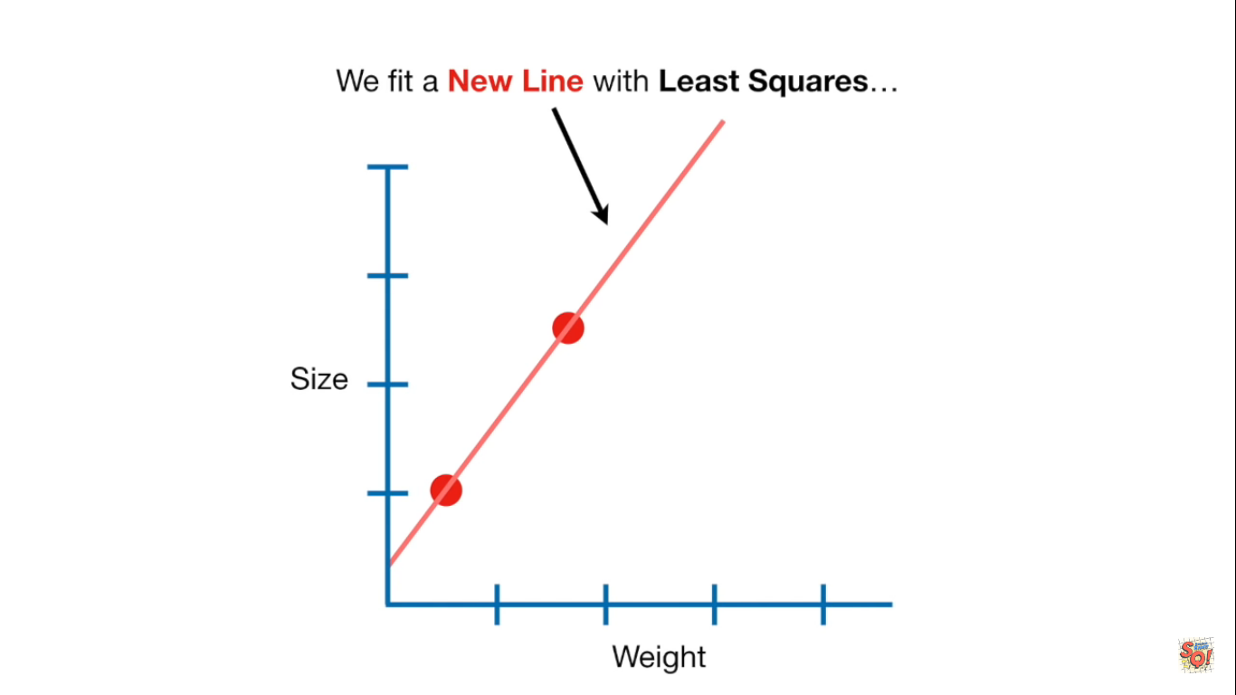
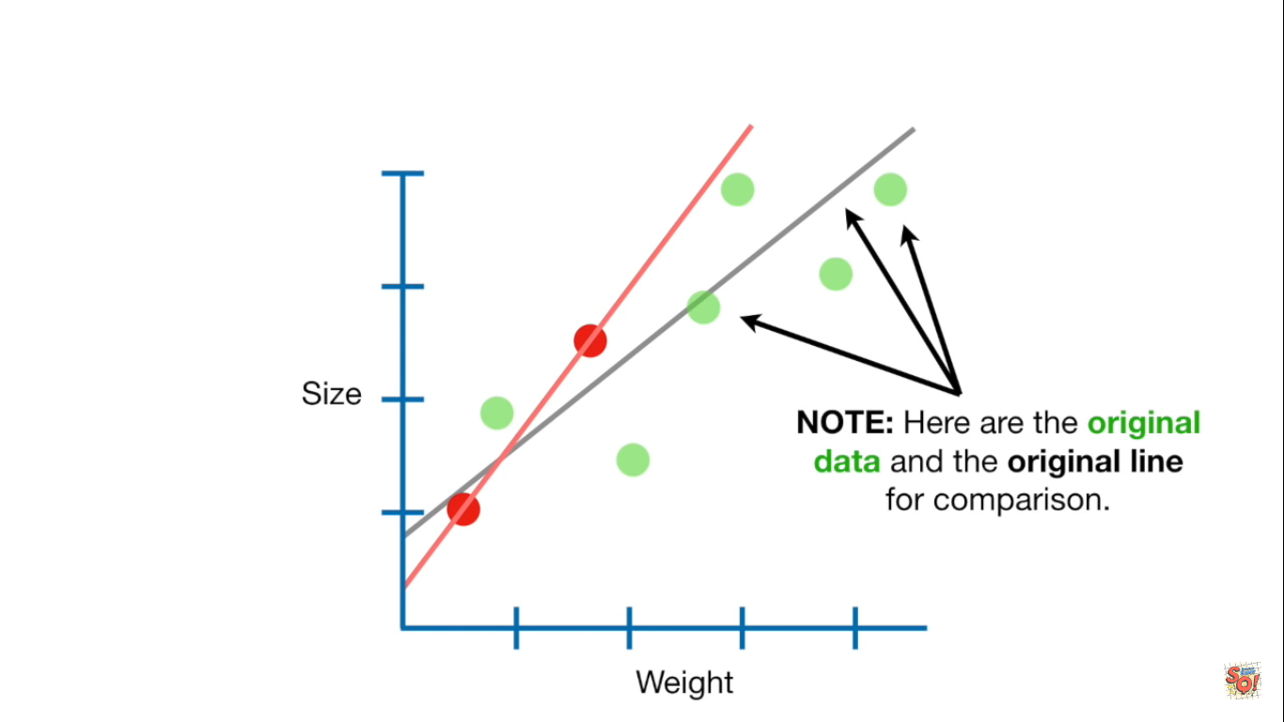
Shrinkage methods prevent overfitting
Overly flexible models cause high variability
“Shrinking” the value of predictor coefficient estimators towards zero makes the model less flexible
Linear regression line fit on small dataset
… vs. the line that would’ve been fit with a larger dataset
Notes:
Let’s discuss the concept of shrinkage in general terms. The concept of shrinkage means that we are “shrinking” the value or magnitude of coefficient estimators towards zero to make the model less flexible. As you recall from other modules, overly flexible models cause high variability which is undesirable and tied to overfitting. Shrinkage prevents overfitting statistical models.​
Consider the example on the right where a linear regression is fit on a small data set. If we fit a line to these points, we might overly rely on the data at hand versus a line that might have been fit with a larger data set we collected in the future.

Slide 24
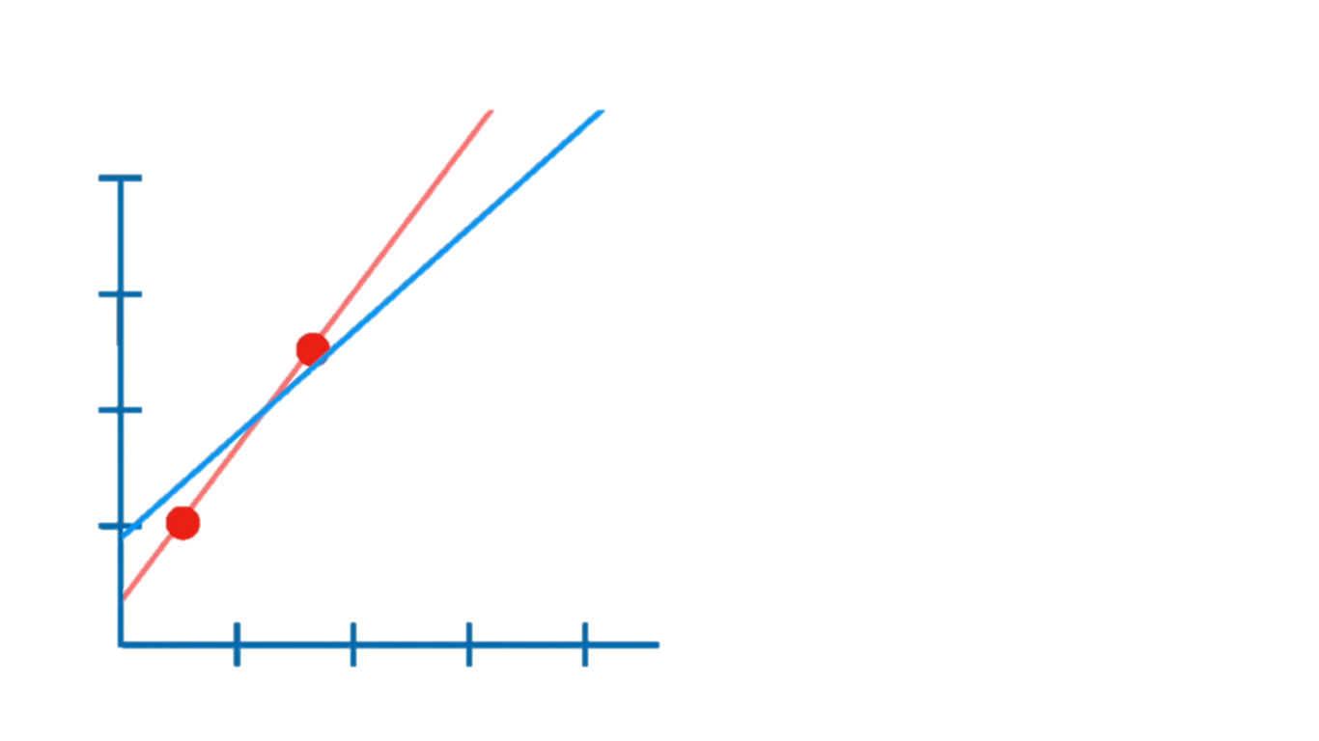
Ridge regression adds a penalty to flexible models
Makes it harder for data points to influence the slope coefficients
Favors models with smaller coefficients
Ridge regression vs. linear regression on our small dataset
Ridge regression
Linear regression
Notes:
Ridge Regression implements a small modification to the classic linear model; adding a penalty term which causes the fitting process to favor models with smaller coefficients
In other words, it becomes harder for datapoints to influence the slope coefficients away from the baseline of zero (horizontal line)
The larger the tuning parameter, the harder it is for datapoints to influence the slopes

Slide 25
Ridge regression adds a penalty to flexible models
Makes it harder for data points to influence the slope coefficients
Favors models with smaller coefficients
Notice how the ridge regression line fits our larger dataset better
Ridge regression
Linear regression (small dataset)
Linear regression (large dataset)
Notes:
This concept is further illustrated on this slide where we see the ridge regression estimate more closely aligned with the linear regression model on the larger data set.​
Basically, ridge regression makes it harder for the data points to influence the slope coefficients by adding a penalty to flexible models.​
This penalty reduces the variances of the parameters in the linear regression models but introduces a small amount of bias.

Slide 26
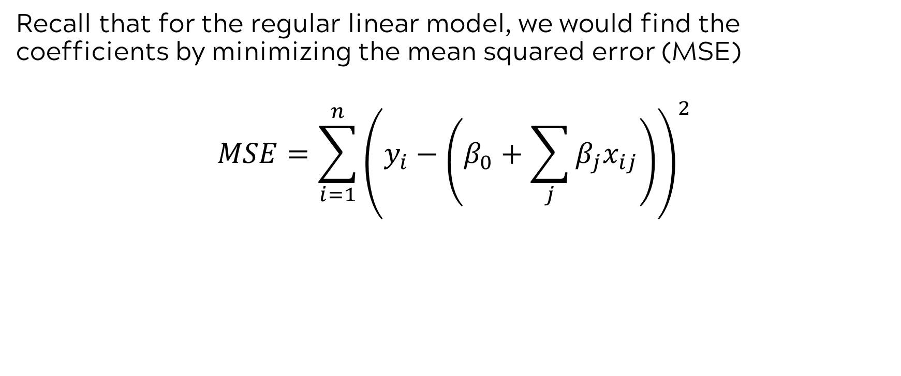
Linear regression coefficient estimates minimize MSE
Recall that for the regular linear model, we would find the coefficients by minimizing the mean squared error (MSE)
$$MSE=\sum_{i=1}^{n}{{\left(y_{i}−\left(β_{0}+\sum_{j}{β_{j}x_{ij}}\right)\right)}^{2}}$$
Observed outcome
The intercept of our linear model
The portion of our linear model influenced by the variables (“slope”)
Notes:
Refresh on linear regression estimation.
Minimize MSE by taking the derivatives with respect to $β_{0}$ and $β_{1}$, setting them equal to 0, and solving

Slide 27
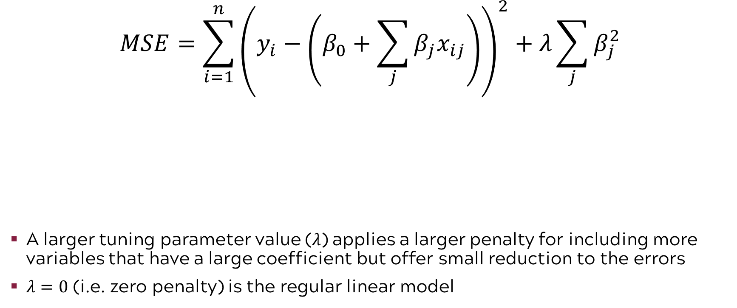
For ridge regression, we minimize the following expression
$$MSE=\sum_{i=1}^{n}{{\left(y_{i}−\left(β_{0}+\sum_{j}{β_{j}x_{ij}}\right)\right)}^{2}+λ\sum_{j}{β_{j}^{2}}}$$
A larger tuning parameter value (𝜆) applies a larger penalty for including more variables that have a large coefficient but offer small reduction to the errors
$λ=0$ (i.e. zero penalty) is the regular linear model
Model coefficients squared
Observed outcome
Tuning parameter
The intercept of our linear model
The portion of our linear model influenced by the variables (“slope”)
Notes:
For ridge regression, we instead find the model that minimizes the expression seen here
An additional parameter is estimated in ridge regression. This tuning parameter, denoted by the Greek letter lambda, is known as the shrinkage parameter. Larger values of lambda increase bias and reduce variability.
As 𝜆 decreases, the estimators converge to least squares estimators (𝜆=0); as it increases, the model fitting process favors smaller estimators, and thus shrinks them towards zero

Slide 28
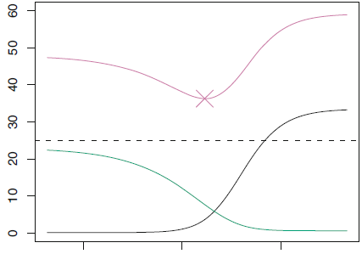
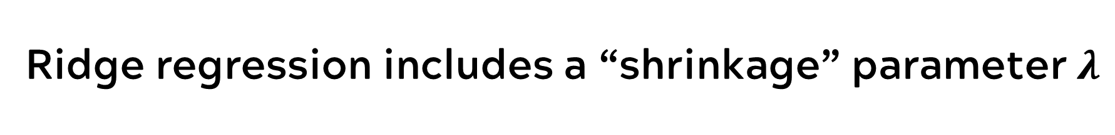
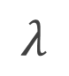
Ridge regression includes a “shrinkage” parameter $λ$
As 𝜆 increases →→ less flexible, and thus high bias and low variability
Recall the important ML concept of the bias-variance tradeoff
Sweet spot
High flexibility
Low flexibility
$$λ$$
0.1 1 1000
Test MSE
Variance
Squared Bias
Notes:
An additional parameter is estimated in ridge regression. This parameter, denoted by the Greek letter lambda, is known as the shrinkage parameter. Larger values of lambda increase bias and reduce variability. ​This brings us back to one of the big ideas in machine learning which is the bias variability tradeoff.​ The value of lambda is chosen by cross validation. Again, we encourage you to seek out a source such as James, et. al.’s Introduction to Machine Learning if you want to know more.
Consider the graph showing test MSE for simulated data
As $λ$ increases, the ridge regression is less flexible (different datasets do not produce very different estimators), but unlike the classic linear model, the estimators are biased
Ridge regression improves the model by means of a trade-off where we slightly increase bias, but obtain a larger decrease in variance, thereby reaching an overall lower MSE
As 𝜆 decreases, the estimators converge to least squares estimators; as it increases, the model fitting process favors smaller estimators, and thus shrinks them towards zero

Slide 29
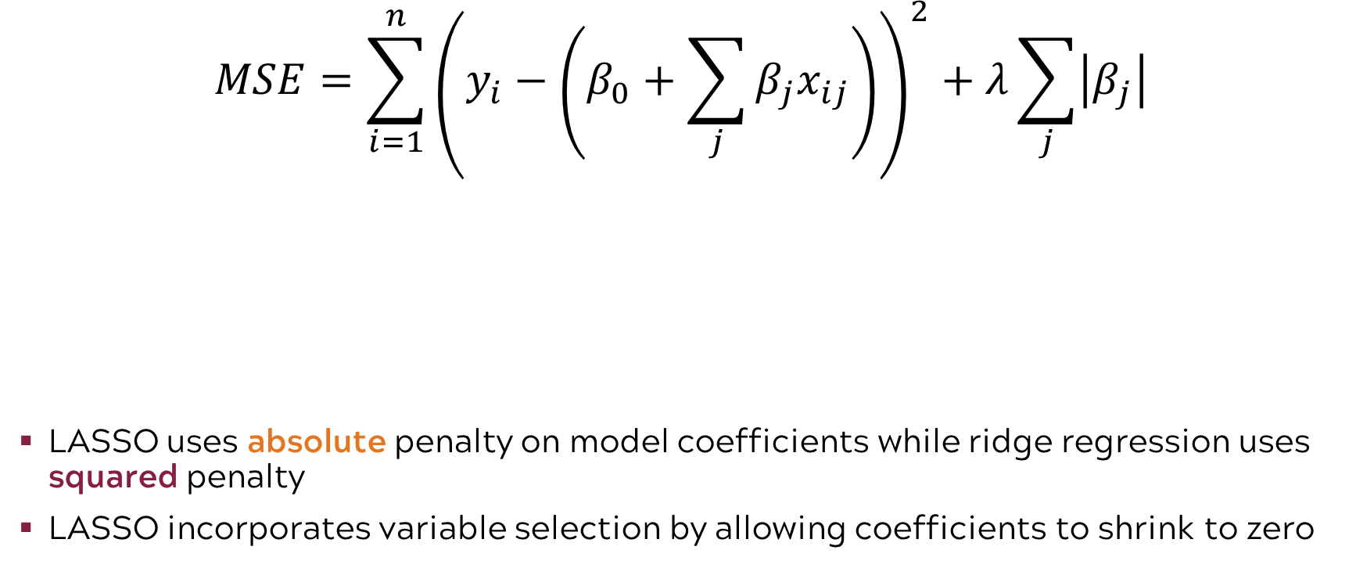
LASSO (least absolute shrinkage and selection operator) minimizes a slightly different expression
$$MSE=\sum_{i=1}^{n}{{\left(y_{i}−\left(β_{0}+\sum_{j}{β_{j}x_{ij}}\right)\right)}^{2}+λ\sum_{j}{\left|β_{j}\right|}}$$
LASSO uses absolute penalty on model coefficients while ridge regression uses squared penalty
LASSO incorporates variable selection by allowing coefficients to shrink to zero
Absolute value of model coefficients
Observed outcome
Tuning parameter
The intercept of our linear model
The portion of our linear model influenced by the variables (“slope”)
Notes:
LASSO is known as the Least Absolute Shrinkage Selection Operator. It is similar to ridge regression in that it imposes a penalty on the estimation process that prevents the coefficients from overfitting to the data.​
The penalty used by ridge regression does not allow for coefficient values to become zero. However, the LASSO penalty allows coefficients or slopes to become zero. Effectively, this incorporates variable selection into the model by allowing regression coefficients or slopes to be eliminated from the model on the basis of their zero value.​
A coefficient with a zero value (zero slope) has no impact on the response and is not included in the model.​

Slide 30
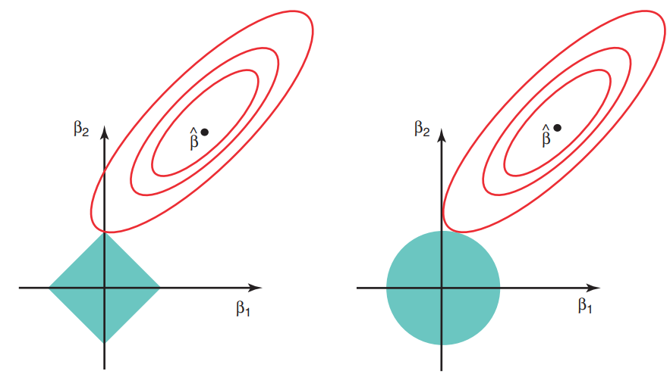
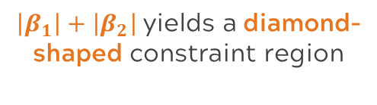
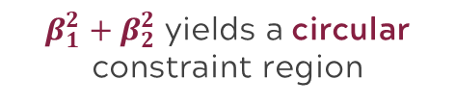
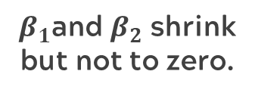
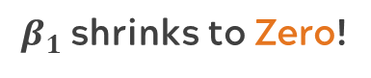
Ridge regression uses a squared penalty and LASSO uses an absolute value penalty
2D Example
Ridge regression shrinks estimators, but none exactly to 0 (only asymptotically).
LASSO may shrink some estimators exactly to 0
This means LASSO can be used for variable selection by examining which estimators go to 0!
Ridge
LASSO
$β_{1}^{2}+β_{2}^{2}$ yields a circular constraint region
$\left|β_{1}\right|+\left|β_{2}\right|$ yields a diamond-shaped constraint region
$β_{1}$and $β_{2}$ shrink
but not to zero.
$β_{1}$shrinks to Zero!
Notes:
Explain figure:
The solid blue areas are the constraint regions (|β1| + |β2| ≤ s and β1^2 + β2^2≤ s).
The red ellipses are the contours of the RSS.
Point out where those areas touch and explain the changes in β1, β2 from OLS(β hat).
How does the absolute value term make a difference? An absolute value term assigns equal penalties to a same magnitude reduction in any coefficient, whereas a quadratic term produces smaller penalties for already small coefficients, causing the fitting process to shift away from shrinking already small terms in favor of larger ones.
In the diagram, the axes represent the regression coefficients:
The horizontal axis is β1\beta_1β1​ — the coefficient for predictor 1
The vertical axis is β2\beta_2β2​ — the coefficient for predictor 2
So, each point in the plane corresponds to a possible combination of values for β1\beta_1β1​ and β2\beta_2β2​. This is a 2D slice of the coefficient space, and the diagram helps visualize how:
The loss function contours (red ellipses) represent levels of constant residual sum of squares (RSS).
The constraint region (blue shape) restricts the set of allowed coefficient values depending on the penalty type (Lasso or Ridge).
The solution is the point where the lowest loss contour intersects the constraint region, illustrating how regularization shapes the final estimates.
This diagram provides a geometric comparison of Lasso and Ridge Regression in terms of how they constrain the coefficient estimates (β1,β2)(\beta_1, \beta_2).
🔵 Understanding the Components of the Diagram:
Red Ellipses: These are contours of the least squares loss function — all points on an ellipse represent combinations of (β1,β2)(\beta_1, \beta_2) that yield the same value of residual sum of squares (RSS). The center point β^\hat{\beta} is the ordinary least squares (OLS) solution (i.e., the minimum RSS without constraints).
Blue Shapes: These represent the constraint regions imposed by the penalty term:
Right: Lasso (L1L_1 penalty) — a diamond shape
Left: Ridge (L2L_2 penalty) — a circle
The final solution is the point where the smallest ellipse touches the constraint region.
🟥 Right Panel: Lasso Regression
Constraint Shape: Diamond (L1L_1 norm ≤ some constant).
Key Insight: The corners of the diamond encourage sparsity, meaning that the optimal solution often lies on an axis, setting one coefficient exactly to zero.
Interpretation: Lasso performs variable selection — it can shrink some coefficients all the way to zero.
🔵 Left Panel: Ridge Regression
Constraint Shape: Circle (L2L_2 norm ≤ some constant).
Key Insight: The circular shape leads to shrinkage of coefficients toward zero, but rarely exactly to zero.
Interpretation: Ridge reduces model complexity, but keeps all variables in the model with smaller coefficients.
⚖️ Summary of the Visual Message

Slide 31
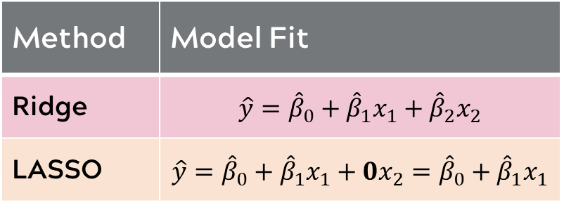
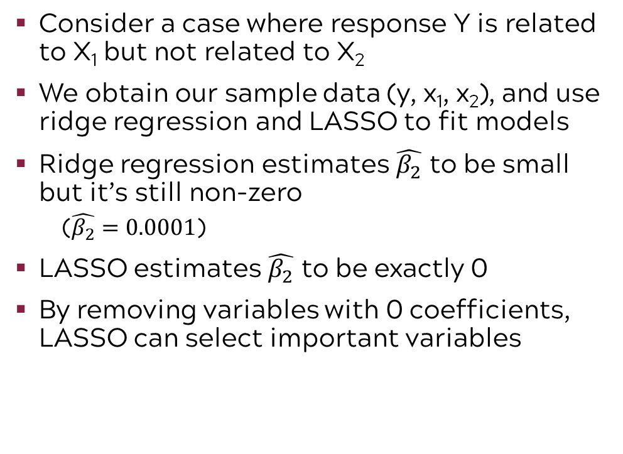
LASSO can be used for variable selection
Consider a case where response Y is related to X₁ but not related to X₂
We obtain our sample data (y, x₁, x₂), and use ridge regression and LASSO to fit models
Ridge regression estimates $\hat{β_{2}}$ to be small but it’s still non-zero
($\hat{β_{2}}=0.0001$)
LASSO estimates $\hat{β_{2}}$ to be exactly 0
By removing variables with 0 coefficients, LASSO can select important variables
Method | Model Fit
Ridge | $$\hat{y}={\hat{β}}_{0}+{\hat{β}}_{1}x_{1}+{\hat{β}}_{2}x_{2}$$
LASSO | $$\hat{y}={\hat{β}}_{0}+{\hat{β}}_{1}x_{1}+0x_{2}={\hat{β}}_{0}+{\hat{β}}_{1}x_{1}$$

Slide 32
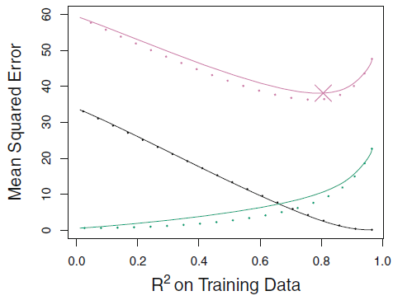
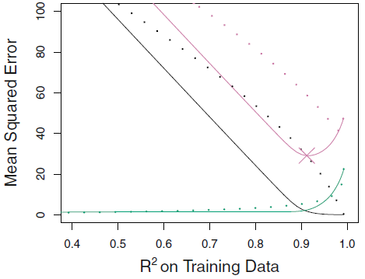
Which is better? Ridge regression or LASSO?
Case1: All variables are related to response
Case2: Only some variables are related to response
Ridge regression has slightly lower Test MSE than LASSO
Overall performance is similar
Test MSE (Ridge)
LASSO has lower Test MSE than Ridge regression
LASSO performs better
Variance (Ridge)
Squared Bias (Ridge)
Test MSE (LASSO)
Variance (LASSO)
Squared Bias (LASSO)
Notes:
So which one should you use? Ridge regression or LASSO? The answer comes from exploring the MSE in different situations. Recall that we want a low test mean squared error from our introduction models on machine learning. We will use the Test MSE in this comparison of Ridge vs. LASSO.​
If you consider the case where all variables are related to the response then ridge regression performs slightly better than LASSO. In the case where only some variables are related to the response then LASSO performs better. ​
​Two Figures in this slide:
Comparison of squared bias, variance and test MSE between lasso (solid) and ridge (dashed).
Both are plotted against their R2 on the training data, as a common form of indexing.
The crosses in both plots indicate the lasso model for which the MSE is smallest.
Explain the legends clearly (ex. Test MSE for Ridge regression is shown by the dotted pink line) and their performances under two different cases.
Left Side:
All Variables Related- Perform similarly
Ridge and Lasso Track together
Right Side:
Some Variables Related – Lasso is better
Bias for Lasso and consequently MSE is lower

Slide 33
Summary of shrinkage methods
Shrinkage Method | Characteristics
Ridge Regression | Developed to deal with overfitting due to multicollinearity Uses squared coefficient penalty
LASSO (Least Absolute Shrinkage & Selection Operator) | Addresses overfitting due to multicollinearity Uses absolute value penalty Allows for variable selection Accommodates more predictors than data points
Elastic Net (Combination of Ridge & LASSO – not covered) | Addresses overfitting due to multicollinearity Uses a combination of absolute value and squared coefficient penalties Allows for variable selection Accommodates more predictors than data points Reduces dependency of variable selection on the data
Notes:
We now want to summarize the key features of the two shrinkage methods previously covered in this chapter and introduce elastic net which is a combination of both ridge and LASSO.​
Ridge regression was the first mainstream shrinkage method developed to deal with multicollinearity using the L2 norm or squared coefficient penalty.​
LASSO is the Least Absolute Shrinkage Selection Operator which addresses multicollinearity and provides for variable selection using the L1 or absolute value norm on the coefficients. It also accommodates more predictors than data points which cannot be accommodated in a typical regression model that starts by introducing all predictors in the model.​
While not addressed specifically in this module until now, it is worth mentioning elastic net. Elastic net combines the penalties from both ridge regression and LASSO. It has all the features of LASSO but also reduces the dependency of variable selection on the data.​
In all cases, shrinkage parameters are chosen by cross validation techniques. The basic idea of cross validation is explained in the machine learning module entitled cross validation. However, it does not specifically cover cross validation as related to the choice of the shrinkage parameter. We encourage you to consult sources such as James, et. al Introduction to Statistical Learning, or take more advanced training courses in order to learn more of the details.​
​

Slide 34
Linear Model Improvements

Slide 35
Predicting the number of college applications
Private
Top25perc
Books
perc.alumni
Apps
F.Undergrad
Personal
Expend
P.Undergrad
PhD
Grad.Rate
Enroll
Outstate
Terminal
Top10perc
Room.Board
S.F.Ratio
Top25perc
Apps
Expend
Enroll
Outstate
Top10perc
Private
Top25perc
Books
perc.alumni
Apps
F.Undergrad
Personal
Expend
P.Undergrad
PhD
Grad.Rate
Enroll
Outstate
Terminal
Top10perc
Room.Board
S.F.Ratio
Start
Subset
Shrink
Dimension Reduction
Notes:
Recall our example where we are interested in predicting the number of college applications. While we could fit the multiple linear regression model with all 17 variables, we know this could lead to issues with interpretability and overfitting. In the last section, we looked at shrinkage methods which are used for correlated Xs in regression. Some shrinkage methods also incorporate the concept of variable selection.
Now let’s look at dimension reduction
​
Subset selection focuses on getting the right variables. While shrinkage and dimension reduction focus on reducing the effect of correlated predictors

Slide 36

Dimension reduction has become more important as the amount of data continues to grow
More data & more predictors →→ Increased chance of overfitting
Dimension reduction helps balance the bias-variance tradeoff
Notes:
Dimension reduction can be thought of as a constraint on the coefficients of a classic linear model. Recall the bias-variance trade-off; constraining the form of the coefficients creates a less flexible model that may be subject to more bias but less variability
Nowadays dimension reduction techniques have become critically important; we have more data than ever, and more predictors than ever. This increases the probability of observing meaningless correlations, which lead to overfitting problems (incorporating variables that work well on the training data by luck alone will cause the model to perform poorly for test data)

Slide 37

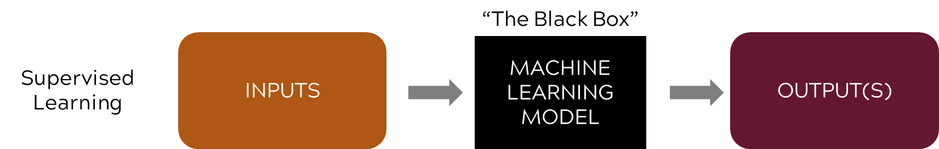
Example: Employment agency
We are interested in predicting the probability of employment based on education and training, employment history, unemployment agency interactions, interest inventory, and behavioral questionnaire.
We are going to work on reducing the number or dimension of inputs (or predictors) by creating new inputs that are combinations of the original inputs.
Notes:
Often the purpose of using machine learning is to sort through large data sets and create predictive models.
Often subject matter experts understand underlying constructs that should impact prediction.
Our predictors are related to these constructs but don’t measure them directly. For example, there is not direct measure of happiness but you might be able to rate your agreement with a number of statements that indicate your degree of happiness. Psychologists could then convert these ratings into a happiness score.
Note that some of the techniques we will discuss for dimension reduction can be used in both supervised and unsupervised learning

Slide 38
Using dimension reduction, we are able to reduce the 25+ original inputs down to 5 “new inputs”
Unemployment Agency Interactions
Attendance at agency seminars
Attendance at weekly agent check-ins
Number of job applications filed
Interviews attended
Etc.
Employment History
Employment history start date
Number of jobs since first job start date
Duration of last 3 jobs
Number of involuntary separations
Industry type for previous positions
Etc.
Interest Inventory
I like to work outside.
I like to make things with my hands.
I like manual labor.
I like working in an office.
I like jobs that use mathematics.
I like working on computers.
Etc.
Reliability Score
Office Job Score
Manual Labor Score
Training Score
Higher Ed Score
Education & Training
Years of High School
Years of College
College Degree Type
Apprentice
Journeymen Certification
Vocational Certificate Type
Etc.
Behavioral Questionnaire
I like to solve problems.
I like to work in teams.
I like to work individually.
I like to do the same thing every day.
I like to tackle a new challenge everyday.
Etc.
Notes:
Reduce the number or dimension of inputs (or predictors) by creating new inputs that are combinations of the original inputs.

Slide 39


A word of caution: Everybody needs a SME!
Effective use of dimension reduction typically requires a Subject Matter Expert or “SME”
Typically we want our reduced dimensions to represent something meaningful in the field of application
A SME may be required to interpret the reduced dimensions

Slide 40
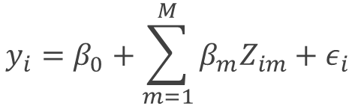
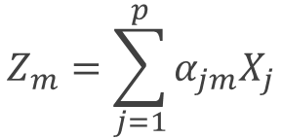
The mathematics of dimension reduction
Some tangible measurement(s)
“The Black Box”
INPUTS:
Predictors or Xs are transformed to new variables Zs
MACHINE LEARNING MODEL
OUTPUT(S)
Supervised Learning
Step 1: Build a linear model of the predictors
Step 2: Fit a linear model using the new predictors
$$Z_{m}=\sum_{j=1}^{p}{α_{jm}X_{j}}$$
$$y_{i}=β_{0}+\sum_{m=1}^{M}{β_{m}Z_{im}}+ε_{i}$$
Zs are linear combinations of X. We have a methodology for creating those linear combinations
“Zs are the new X!” for our machine learning model

Slide 41
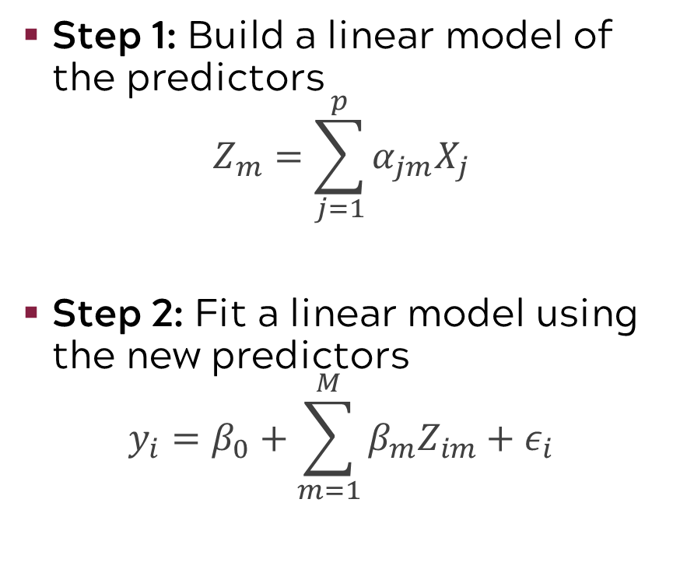
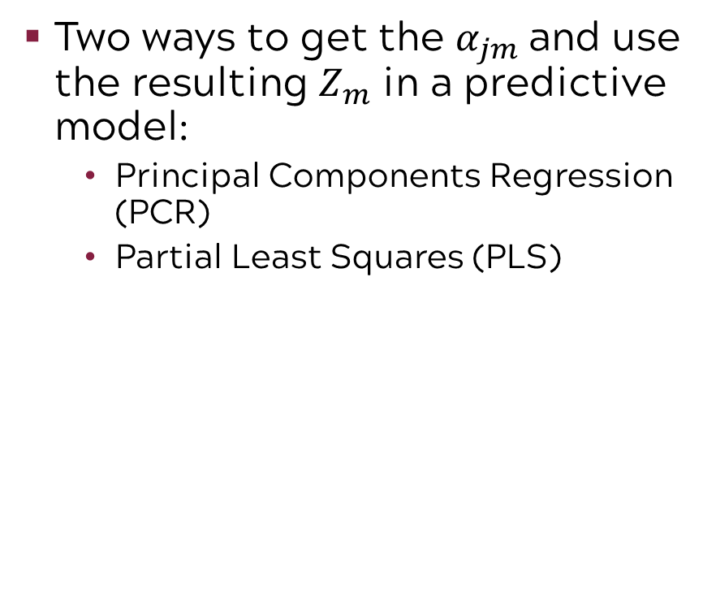
Dimension reduction transforms the predictors
Step 1: Build a linear model of the predictors
$$Z_{m}=\sum_{j=1}^{p}{α_{jm}X_{j}}$$
Step 2: Fit a linear model using the new predictors
$$y_{i}=β_{0}+\sum_{m=1}^{M}{β_{m}Z_{im}}+ε_{i}$$
Two ways to get the $α_{jm}$and use the resulting $Z_{m}$ in a predictive model:
Principal Components Regression (PCR)
Partial Least Squares (PLS)
Notes:
Unlike the previous two approaches to reducing variance and improving interpretability, dimension reduction transforms the predictors themselves.
One method of dimension reduction involves building linear combinations of the original variables then using the output of these models as the predictors instead of the original predictors:

Slide 42
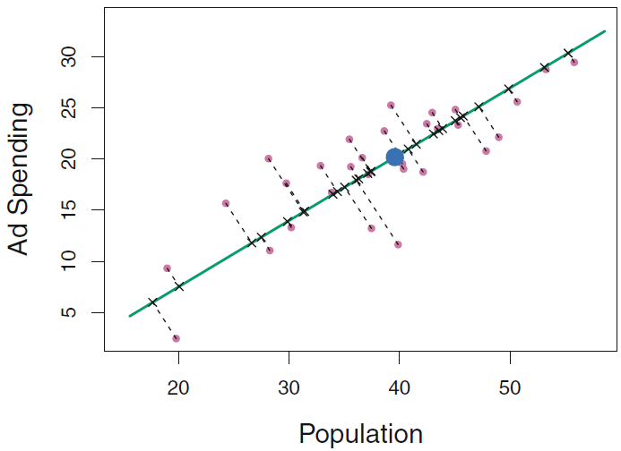
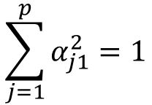
A conceptual introduction to principal components
The green line represents the 1st PC. This is the line (or plane) closest on average to all the data points subject to the constraint:
$$\sum_{j=1}^{p}{α_{j1}^{2}=1}$$
Notes:
Principal components works with a large number of predictors but it helps to look at a simple case to understand what is happening in PCA.
Consider two predictors variables in a predictive model for regional sales revenue. Those two predictors are advertisement spending and regional sales revenue. We will find the alphas by finding the line/plane that is closest on average to all the data points while normalizing the coefficients of the linear form as follows so that the sum of the squared coefficients adds to 1.
PCR follows closely from the general formulation we described earlier. Instead of using any linear combination, we find the line/plane that is closest on average to all the data points while normalizing the coefficients of the linear form as follows:
The result, 𝑍_1, is known as the first principal component. The second component is derived similarly

Slide 43
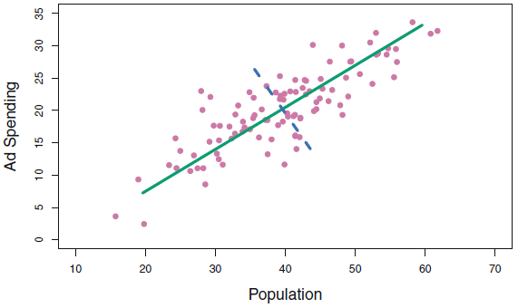
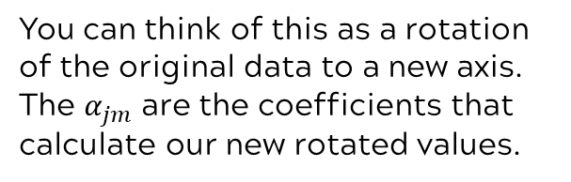
The second principal component is orthogonal (or uncorrelated) to the first
You can think of this as a rotation of the original data to a new axis. The $α_{jm}$ are the coefficients that calculate our new rotated values.
The green line represents the 1st principal component (PC1). The blue line represents the second (PC2).
Notes:
What, then, separates the second from the first PC? The second principal component must be orthogonal/uncorrelated with the first
We can repeat the process up to p times (the number of original variables)
Finally we use our newly constructed components to build a linear model

Slide 44

How many principal components?
In any data analysis, you can estimate up to p principal components where p is the number of variables. Of course, if you use all p, that doesn’t reduce dimensions.
Goal: Find some number of principal components c < p that represent a large portion of the variability in your original variables.
Look Mom! I had 500 variables but I can explain 89% of the variation in the variables with 4 principal components! Isn’t that exciting!?!
89
This Photo by Unknown Author is licensed under CC BY
Notes:
In general, we can have up to the smaller of p or n-1 principal components, where p is the number of variables and n is the number of observations. But of course, choosing p principal components would not reduce the dimensions in our data at all! Instead, the goal is to find a small number of principal components that explain a large portion of the variability present in the original variables.

Slide 45
We want to choose the smallest number of PCs required to explain a “large” percent of the variability in the data
For example, 3 principal components explaining 92% of variation is preferable to 7 principal components explaining 97% of the variation
TRADEOFF
Less PCs More PCs
More data reduction
( + ) easier to visualize
( – ) less flexibility when working with data
Less data reduction
( – ) more difficult to visualize
( + ) more flexibility when working with data
Notes:
But how do we choose the number of principal components? Ideally, We want the smallest number of principal components required to explain a “large” percent of variability ​
Large here is a little subjective. For example, 3 components explaining 92% of variation would be preferable to 7 principal components explaining 97%. Even though 7 components explains a higher percent of variation, this does not achieve as much dimension reduction. ​
In general, there is a tradeoff in selecting the number of principal components. The less PCs we have, the more data reduction we achieve and the easier it is to visualize the data, but we will have less flexibility. When we have more PCs, we achieve less data reduction and thus the data is more difficult to visualize, but we will have more flexibility in working with the data. ​
Software will give you a Percent of Variability Explained

Slide 46
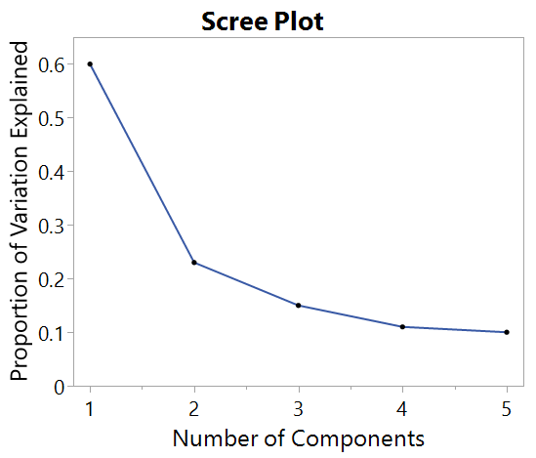
In addition to percent variation explained, scree plots help select the number of principal components
We “eyeball” scree plots to find the “elbow” (i.e., the point at which the proportion of variance explained by each subsequent PC drops off)
In this example, we may opt to use only PC1 and PC2
Notes:
One tool commonly used to aid in selecting the number of principal components is the scree plot. The scree plot for PCA displays the proportion of variability in the data explained as we increase the number of principal components. There is no strict criteria for selecting the number of components this way and it is important to consult a subject matter expert at this stage.
Typically, we look for an elbow shape in the scree plot where the proportion of variance explained by each subsequent principal component drops off. In other words, we would have little to gain in terms of variability explained by adding more components beyond the number of components found at the elbow.
In this graph, there seems to be an elbow after the second component
The third principal component explains less than ten percent of the variance in the data
We might opt to have only two principal components

Slide 47
Scree plot warnings
The “elbow” is not always clear
Scree plots tend to overestimate the number of PCs
Good
Not so good
The “Elbow”
No “Elbow”
Notes:
Note that it is sometimes unclear where the elbow lies on the plot or there may be multiple elbows, but these plots can still give you a rough idea of how many components you may want.
Another warning with these plots is that they tends to overestimate the number of components needed. Remember, these plots can be used to help make a judgement call. Often whether or not you use a component doesn’t only depend on the variability it explains but also the interpretability of that component. If a component doesn’t make sense to your subject matter expert and only explains 4% of the variability, it is less likely that you should use that component.
Note: Eigenvalues can also be used to select the number of PCs with >1 criteria but that is beyond the scope of this course

Slide 48
Pros and cons of principal component regression
Pros
Cons
PCR works well when there are well-defined linear relationships between the predictors
We gain the most benefit from PCR when our linear model does well with few Principal Components. (Main Idea of Dimension Reduction!)
PCR does not help with variable selection
No guarantee that resulting principal components are related to the responses. They weren’t constructed with responses in mind.
Notes:
PLS is the Remedy for accounting for responses.

Slide 49
Partial Least Squares (PLS) is a method to account for the responses (or outputs)
Finds the PCs so that they are most related to responses
While not covered here, note that PLS can be used to model a many to many relationship!
Z
U
Predictors or Xs
Responses or Ys
Notes:
If you have more than one Y, then PLS converts the Ys to PCs

Slide 50
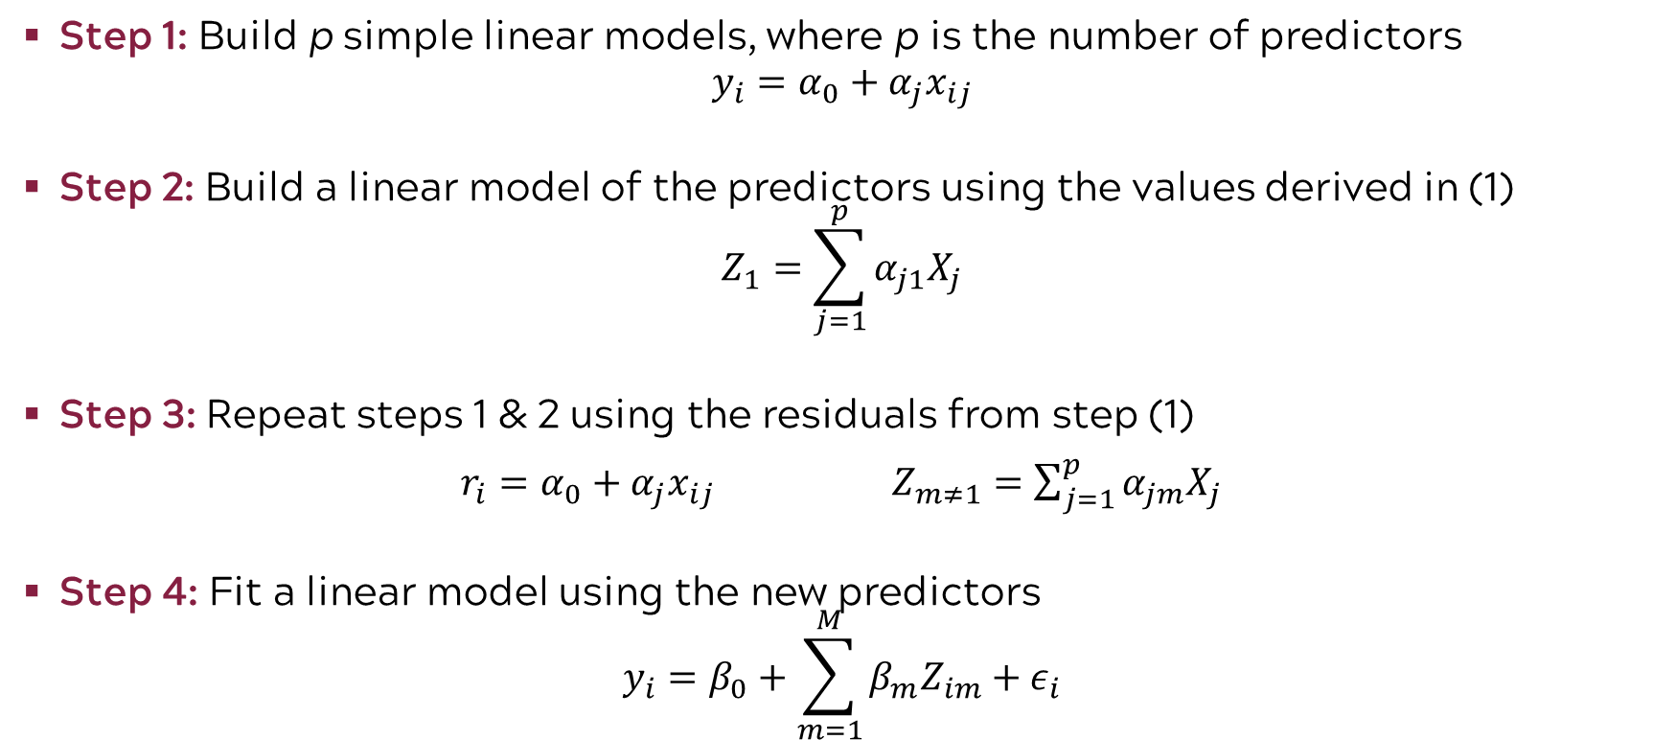
The PLS algorithm for a single Y (response or output)
Step 1: Build p simple linear models, where p is the number of predictors
$$y_{i}=α_{0}+α_{j}x_{ij}$$
Step 2: Build a linear model of the predictors using the values derived in (1)
$$Z_{1}=\sum_{j=1}^{p}{α_{j1}X_{j}}$$
Step 3: Repeat steps 1 & 2 using the residuals from step (1)
$r_{i}=α_{0}+α_{j}x_{ij}$ $Z_{m≠1}=\sum_{j=1}^{p}{α_{jm}X_{j}}$
Step 4: Fit a linear model using the new predictors
$$y_{i}=β_{0}+\sum_{m=1}^{M}{β_{m}Z_{im}}+ε_{i}$$

Slide 51
PLS has advantages over PCR
PLS focuses on choosing combinations of factors (Z) that best explain the responses (U)
PLS finds the components of X factors that are most related to Ys
PLS focuses on the covariance structure of the Ys and Xs together

Slide 52
PLS is considered a “soft” technique unlike traditional regression which requires “hard” assumptions
Regression (“hard” assumptions)
PLS (“soft” technique)
Focus on inference
Normality
Independence among regressors
Hypothesis tests with conclusions
Well understood relationships
Focus on the amount of response variation explained by the explanatory variable
Handles collinearity
Lack of understanding about the relationship is okay
Iteratively fits model to residuals

Slide 53
A review of methods to improve the linear model
Improvement Approach | Method | Handles Collinearity | Performs Variable Selection | Produces Parsimonious Models
Sampling-based (previous module) | Cross-Validation | ✅ | ✅(indirectly) | ✅
Sampling-based | Resampling | ✅ | ❌ | ❌
Sampling-based | Bootstrapping | ✅ | ❌ | ❌
Subset Selection | Best Subsets | ❌ | ✅ | ✅
Subset Selection | Forward/Backward | ❌ | ✅ | ✅
Shrinkage | Ridge Regression | ✅ | ❌ | ❌
Shrinkage | Lasso | ✅ | ✅ | ✅
Shrinkage | Elastic Net | ✅ | ✅ | ✅
Dimension Reduction | Principal Components Regression (PCR) | ✅ | ❌ | ✅(via dim. red.)
Dimension Reduction | Partial Least Squares (PLS) | ✅ | ❌ | ✅(via dim. red.)

Slide 54
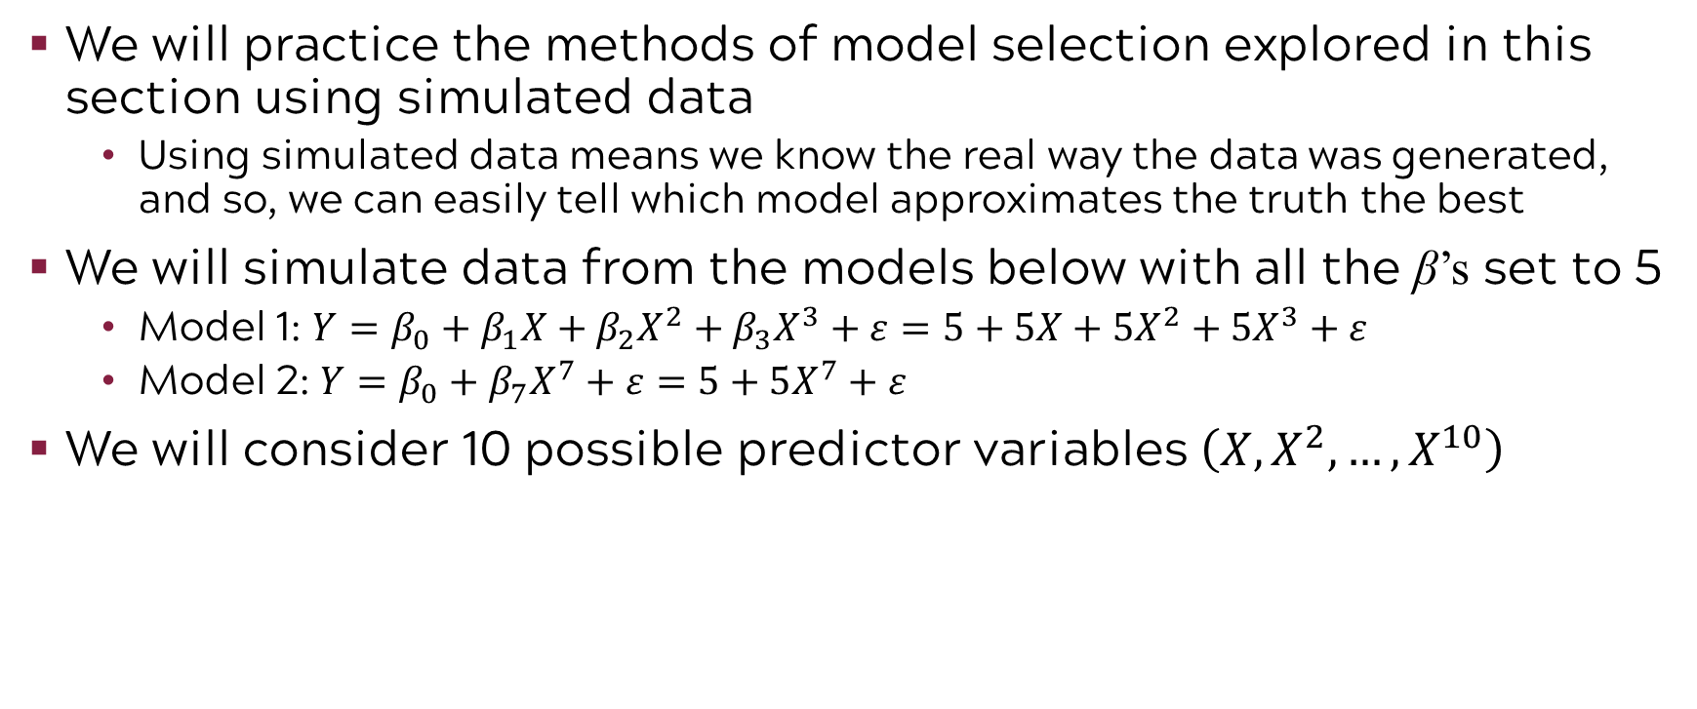
Exercise: Model selection with simulated data
We will practice the methods of model selection explored in this section using simulated data
Using simulated data means we know the real way the data was generated, and so, we can easily tell which model approximates the truth the best
We will simulate data from the models below with all the β’s set to 5
Model 1: $Y=β_{0}+β_{1}X+β_{2}X^{2}+β_{3}X^{3}+ε=5+5X+5X^{2}+5X^{3}+ε$
Model 2: $Y=β_{0}+β_{7}X^{7}+ε=5+5X^{7}+ε$
We will consider 10 possible predictor variables $\left(X, X^{2}, …, X^{10}\right)$

Slide 55
ML paradigm to evaluate model performance
Test Error: average error that results from using a machine learning method to predict the response on data that was not used in training the method
Models are built to do well on the data they’ve been fed. We want to ensure they also do well on data they haven’t encountered.
Whole Sample
Randomly
divide
Training set
Fit
Model
Prediction
Validation set
Tune
Test
Test Error
Test set
Notes:
Before we jump into the exercise, recall the ML paradigm to evaluate model performance with test error
A common way to evaluate its performance in this paradigm is through test error. The model is used to make predictions on the test set, which the model has not yet “seen”, and from these predictions we can get test error. Test error is the average error that results from using a machine learning method to predict the response on data that was not used in training the method. Remember, the model was only built using the training and validation sets, thus it was built to do well on that data. We want to ensure the model will also do well on new data, which is why a test set is used.
Recall for the purposes of this course, we will limit ourselves to training and test (exclude validation)

Slide 56
Code road map
1) Import Modules + Packages
2) Visualize Data
3) Build Training + Test Datasets
4) For each model:
Fit model with training data
Generate predicted labels
Evaluate performance
Notes:
Also recall our code rode map

Slide 57
1) We begin by creating our simulated datasets
R Code
x <- rnorm(100)
err <- 5*rnorm(100)
y <- 5 + 5*x + 5*x^2 + 5*x^3 + err
Creating data
Python Code
X = pd.DataFrame(np.random.normal(size=100), columns=["1"])
epsilon = pd.DataFrame(np.random.normal(size = 100, scale=5), columns=["1"])
y = X.applymap(lambda x : (5 + 5 * x + 5 * (x ** 2) + 5 * (x ** 3)) )
y = y + epsilon
Creating data

Slide 58
2) Now we try out our different model selection algorithms
R Code
Best model selection in all possible models
xydatReg <- regsubsets(y~., data=xydat, method=“exhaustive”, nvmax=10)
xydatRegF <-regsubsets(y~., data=xydat, method="forward", nvmax=10)
xydatRegB <- regsubsets(y~., data=xydat, method="backward", nvmax=10)
Forward selection
Backward selection
Python Code
models = bestModel(y, X, 11)
models = forward_stepwise(y, X)
models = backward_stepwise(y, X)
Best model selection in all possible models
⬇ In the Python code, we pre-defined the functions for model selection so now we have nice compact code
Forward selection
Backward selection

Slide 59
3) Previously, we mentioned the LASSO’s variable selection capabilities. Now we’ll put them to the test on a model where we know which variables should be excluded.
R Code
Fitting a LASSO
xydatLasso<-glmnet(Xdat[trainidx,],y[trainidx],alpha=1,lambda=lambdas)
xydatLassoCV<-cv.glmnet(Xdat,y,alpha=1,lambda=lambdas)
xydatLassoPred<-predict(xydatLasso,s=xydatLassoCV$lambda.min, newx = Xdat[-trainidx,])
LASSO CV for best penalty
LASSO using best setting
Python Code
For loop does CV to find best penalty
for a in alphas:
minAlpha = alphas[MSEDF.idxmin()]
lasso.set_params(alpha=minAlpha)
lasso.fit(X, y)
Configuring LASSO to best setting from loop
LASSO using best setting

Slide 60
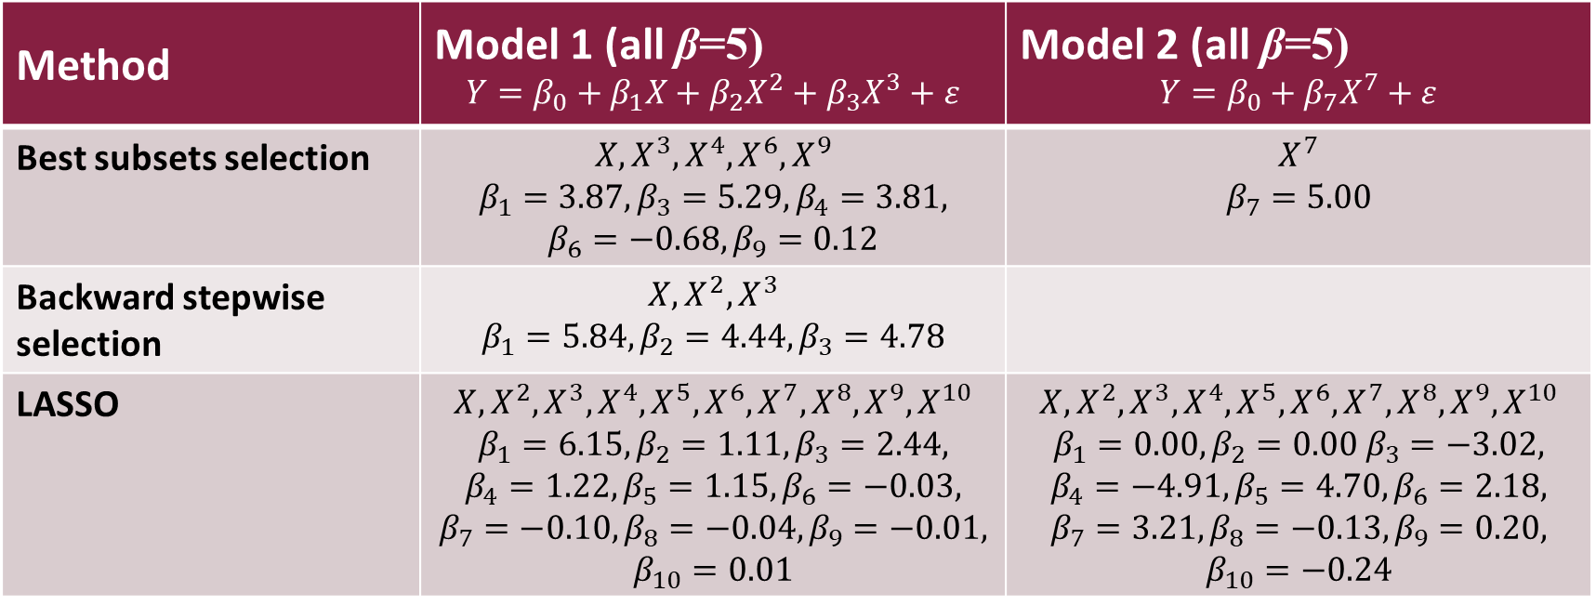
Results: Backward performed best for model 1 and best subsets for model 2
Method | Model 1 (all β=5) $$Y=β_{0}+β_{1}X+β_{2}X^{2}+β_{3}X^{3}+ε$$ | Model 2 (all β=5) $$Y=β_{0}+β_{7}X^{7}+ε$$
Best subsets selection | $$X, X^{3}, X^{4}, X^{6}, X^{9}$$ $$β_{1}=3.87, β_{3}=5.29, β_{4}=3.81,$$ $$β_{6}=−0.68, β_{9}=0.12$$ | $$X^{7}$$ $$β_{7}=5.00$$
Backward stepwise selection | $$X, X^{2}, X^{3}$$ $$β_{1}=5.84, β_{2}=4.44, β_{3}=4.78$$
LASSO | $$X, X^{2}, X^{3}, X^{4}, X^{5}, X^{6}, X^{7}, X^{8}, X^{9}, X^{10}$$ $$β_{1}=6.15, β_{2}=1.11, β_{3}=2.44,$$ $$β_{4}=1.22, β_{5}=1.15, β_{6}=−0.03,$$ $$β_{7}=−0.10, β_{8}=−0.04, β_{9}=−0.01,$$ $$β_{10}=0.01$$ | $$X, X^{2}, X^{3}, X^{4}, X^{5}, X^{6}, X^{7}, X^{8}, X^{9}, X^{10}$$ $$β_{1}=0.00, β_{2}=0.00 β_{3}=−3.02,$$ $$β_{4}=−4.91, β_{5}=4.70, β_{6}=2.18,$$ $$β_{7}=3.21, β_{8}=−0.13, β_{9}=0.20,$$ $$β_{10}=−0.24$$

Slide 61
Linear Model Improvements

Slide 62
Introduction to Machine Learning Course Roadmap
What is the goal of the data analysis?
Predict an output |  |  |  |  |  | Reveal patterns or relationships |  | Make decisions using an autonomous agent
Supervised Learning (Output in the data set) |  |  |  |  |  | Unsupervised Learning (No output in the data set) |  | Reinforcement Learning* (Supervised & unsupervised)
Continuous or discrete output? |  |  |  |  |  | What is the subgoal? |  | Does a model exist?
Continuous |  |  | Discrete |  |  | Identify groups | Reduce dimensions | Model Based | Model Free
Simple linear regression Multiple linear regression Subset selection Ridge regression & LASSO PCR & PLS | Polynomial regression Step functions Splines Local regression General additive models | Decision tree Random forest Neural network Gradient boosting tree | Logistic regression Linear discriminant analysis Quadratic discriminant analysis | Decision tree Random forest Neural network Gradient boosting tree | Support vector machines | Hierarchical clustering K-means clustering | Principal components analysis | Given the model Learn the model | Policy Optimization Q-Learning
Subset selection
Ridge regression & LASSO
PCR & PLS
*Advanced Topic: Bonus module if time
Notes:
This module examined three approaches to improving the full linear model.
Subset Selection
Shrinkage methods including ridge regression and LASSO
Dimension Reduction methods including principal components regression and partial least squares

Slide 63
Now you should be able to:
Understand why you would want to improve a linear model
Identify methods that can be used to improve the linear model
Describe approaches to subset selection
Explain what is meant by shrinkage
Describe the difference between ridge regression and LASSO
Describe what is meant by dimension reduction
Identify two approaches to dimension reduction
Implement model adjustment methods in Python

